Slide 1


Multimodal Perception
[Professor Name]
[Class and Section Number]
Notes:
Classroom Recommendations: This lesson can be taught in one 50-75 minute class period. However, if you would like to expand this to more than one class period, there is more than enough information contained in the module to cover over two class periods. Please also refer to the Noba Instructor Manual that accompanies this PowerPoint.
Overview: Most of the time, we perceive the world as a unified bundle of sensations from multiple
sensory modalities. In other words, our perception is multimodal. This module provides an overview of multimodal perception, including information about its neurobiology and its psychological effects.
Technical Note: These slides may contain simple click animation so that you can focus students’ attention on a particular question, a selection of text, or an image and not have them be distracted by reading ahead. You can either preview the sequence of animation by going through the slides in slideshow view, visiting the animations tab, or reviewing the slide notes. In the notes you will see a cue - (Click) – that corresponds to each animation.
You may also find hyperlinks to outside videos at various places in the slides. These hyperlinks are embedded in text and indicated by color and in the notes section.

Slide 2
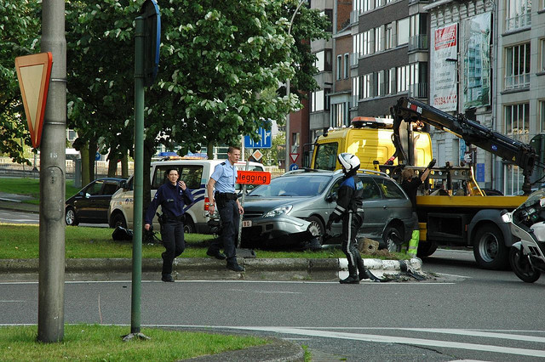
Warm Up Activity:
OMG an Accident!
What did you see?
If you physically witnessed the accident, what do you think you would have heard?
What do you think the smells would be?
Notes:
Warm Up Activity: OMG, an Accident!
Overview: This activity is designed to introduce students to the theory of multimodal perception. It is a starting point for you to engage students in discussing all the factors that are involved in auditory, olfactory, and visual perception.
Time: 2-3 minutes.
Materials: All materials are in the accompanying PowerPoint presentation.
Directions:
Let students know that you are going to briefly show them a picture and that you want them to try and remember everything they see.
Once you (Click) onto this page, the picture will stay on the screen for 10 seconds and then disappear.
Then, the questions behind it will come up:
First, describe what did you see?
If you physically witnessed the accident, what do you think you would have heard?
What do you think this moment would have smelled like?
Give students time to think about the questions, and then have an open discussion about what they observed.
Debrief students on the purpose of the activity.

Slide 3
Overview
Perception Unified
Questions About Multimodal Perception
Biological Bases of Multimodal Perceptions
Behavioral Effects of Multimodal Perception
  Multimodal Phenomena
  Crossmodal Phenomena
Notes:
The purpose of this slide is to provide students with an overview of the material that will be covered during the lecture.

Slide 4
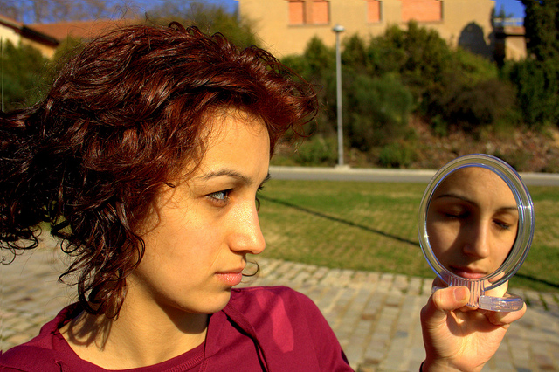



Perception: Unified
Sensory Modalities
Sight
Sound
Smell
Touch
Notes:
The purpose of this slide is to introduce the topic of sensory modalities
In order to discuss multmodal perception, you first must briefly discuss the different sensory modalities. Actively solicit student feedback for each of these modalities. You do not need to spend too much time on this.
(Click): Sight
(Click): Sound
(Click): Smell
(Click): Touch

Slide 5
Multimodal Perception
What is Multimodal Perception?
Notes:
The purpose of this slide is to continue the warm-up discussion on the multimodal perception
Once you (Click) onto this page, it sets off a timer on the image to stay for 10 seconds and then reveal the question behind it.
Discussion Question:
What is multimodal perception?
The effects on the perception of events and objects in the world that are observed when there is information from more than one sensory modality.
Have students reflect back to the warm up activity. Have them describe all the senses that they used.

Slide 6
Overview
Perception Unified
Questions About Multimodal Perception
Biological Bases of Multimodal Perceptions
Behavioral Effects of Multimodal Perception
  Multimodal Phenomena
  Crossmodal Phenomena
Notes:
Mid-Lecture Overview

Slide 7

Questions About Multimodal Perception
How does the perceptual system determine which unimodal stimuli must be integrated?
What are the effects of multimodal perception that would not be present if perceptual processing were only unimodal?
How does the brain take information from different neural systems (optic, auditory, etc.) and combine it?
Notes:
The purpose of this slide is to present discussion questions about multimodal perception
Introduce the main questions that drive research on multimodal perception:
(Click): How does the perceptual system determine which unimodal stimuli must be integrated?
(Click): What are the effects of multimodal perception that would not be present if perceptual processing were only unimodal?
(Click): How does the brain take information from different neural systems (optic, auditory, etc.) and combine it?
For each question, first ask students what they believe the answers to these questions are and then use this as a starting point for discussion, that will follow in the subsequent slides of this presentation.

Slide 8
Overview
Perception Unified
Questions About Multimodal Perception
Biological Bases of Multimodal Perceptions
  Multisensory Neurons & Neural Convergence
  Crossmodal Receptive Fields
  Multimodal Processing in Unimodal Cortex
Behavioral Effects of Multimodal Perception
  Multimodal Phenomena
  Crossmodal Phenomena
Notes:
Mid-Lecture Overview

Slide 9
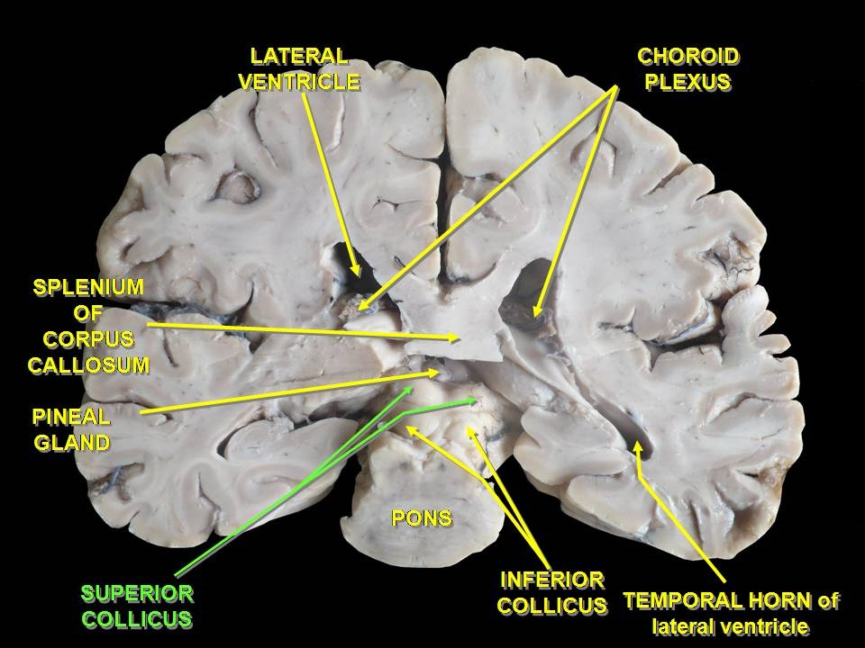
Multisensory Neurons & Neural Convergence
Superior colliculus
Notes:
The purpose of this slide is to discuss the superior colliculus
Direct Instruction: You should provide basic definitions and some examples of the superior colliculus. The superior colliculus is an area in the brain that is responsible (in part) for processing both visual and auditory stimuli and is thought to help us orient ourselves. For example, when we here someone whistle and turn to see where the sound comes from, our superior colliculus (among other regions of the brain) is thought to help us orient or find the location (visual) where the sound (auditory) came from.

Slide 10
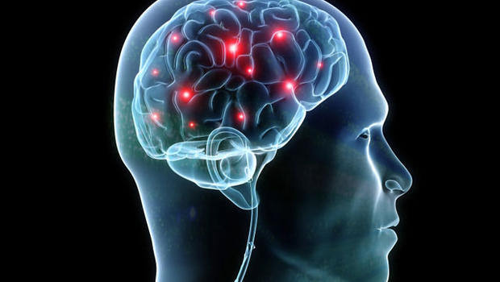
Crossmodal Receptive Fields
Receptive field
Crossmodal receptive fields
Neural convergence
Spatial principle of multisensory integration
Notes:
The purpose of this slide is to discuss the crossmodal receptive fields
Direct Instruction: Basic definitions and some examples should be given of the concepts of receptive field, crossmodal receptive fields, neural convergence, and spatial principle of multisensory integration.
(Click): Receptive Field
(Click): Crossmodal Receptive Fields
(Click): Neural Convergence
(Click): Spatial Principle of Multisensory Integration
From the Module:
Receptive Field:
“The portion of the world to which a neuron will respond if an appropriate stimulus is present there”.
Crossmodal Receptive Field:
“A receptive field that can be stimulated by a stimulus from more than one sensory modality”.
Neural Convergence:
When information from multiple neurons converges on a single neuron.
Spatial Principle of Multisensory Integration:
“The finding that the superadditive effects of multisensory integration are observed when the sources of stimulation are spatially related to one another”.

Slide 11
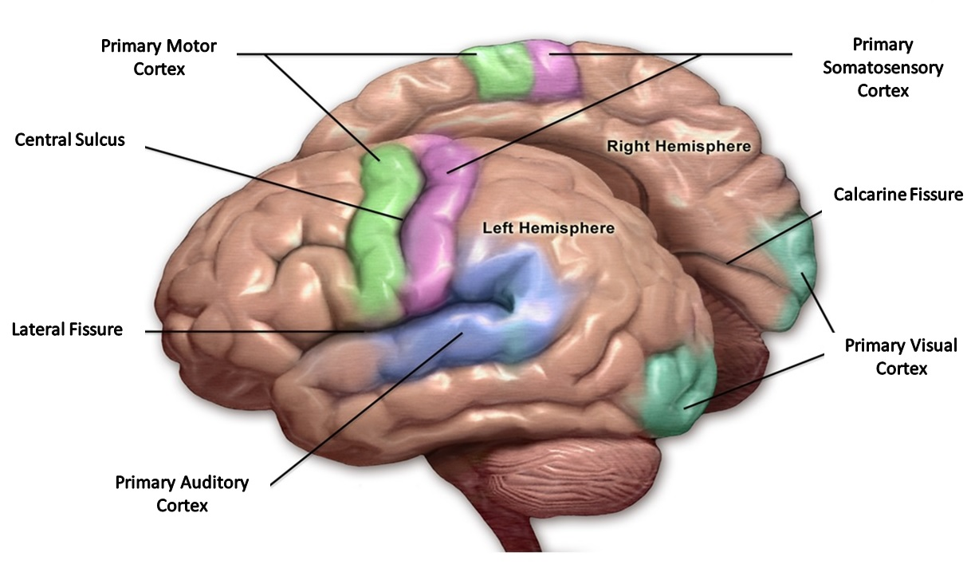
Multimodal Processing in Unimodal Cortex
Notes:
The purpose of this slide is to introduce multimodal processing in unimodal cortex
Direct Instruction: Basic definitions and some examples should be given of the concepts of unimodal cortex, primary visual cortex, primary auditory cortex.
From the Module:
Unimodal Cortex:
“A region of the brain devoted to the processing of information from a single sensory modality”.
Primary Visual Cortex:
“A region of the cortex devoted to the processing of simple visual information”.
Primary Auditory Cortex:
“A region of the cortex devoted to the processing of simple auditory information”.

Slide 12
Overview
Perception Unified
Questions About Multimodal Perception
Biological Bases of Multimodal Perceptions
Behavioral Effects of Multimodal Perception
Behavioral Effects of Multimodal Perception
  Multimodal Phenomena
    Audiovsiual Speech
  Crossmodal Phenomena
Notes:
Mid-Lecture Overview:
Multimodal phenomena—concerns the binding of inputs from multiple sensory modalities and the effects of this binding on perception.

Slide 13
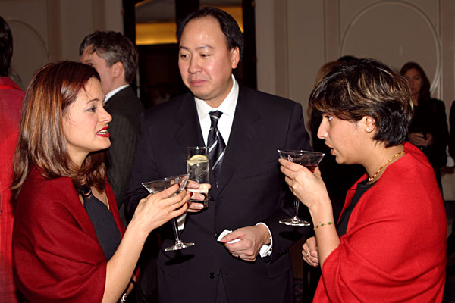
Multimodal Phenomena
Audiovisual Speech
How does visual information about speech interact with auditory information about speech?
Describe this picture. What do you see?
Notes:
The purpose of this slide is to discuss the multimodal phenomena of audiovisual speech
Discussion and Application:
(Click) How does visual information about speech interact with auditory information about speech? Write their answers on the board.
(Click) Now have students describe the picture. What do they see? Relate their observations to audiovisual speech.
From the Module:
“Multimodal phenomena concern stimuli that generate simultaneous (or nearly simultaneous) information in more than one sensory modality. As discussed above, speech is a classic example of this kind of stimulus. When an individual speaks, she generates sound waves that carry meaningful information. If the perceiver is also looking at the speaker, then that perceiver also has access to visual patterns that carry meaningful information”.
Additional Info:
“How does visual information about speech interact with auditory information about speech? One of the earliest investigations of this question examined the accuracy of recognizing spoken words presented in a noisy context, much like in the example above about talking at a crowded party. To study this phenomenon experimentally, some irrelevant noise (“white noise”—which sounds like a radio tuned between stations) was presented to participants. Embedded in the white noise were spoken words, and the participants’ task was to identify the words. There were two conditions: one in which only the auditory component of the words was presented (the “auditory-alone” condition), and one in both the auditory and visual components were presented (the “audiovisual” condition). The noise levels were also varied, so that on some trials, the noise was very loud relative to the loudness of the words, and on other trials, the noise was very soft relative to the words. Sumby and Pollack (1954) found that the accuracy of identifying the spoken words was much higher for the audiovisual condition than it was in the auditory-alone condition. In addition, the pattern of results was consistent with the Principle of Inverse Effectiveness: The advantage gained by audiovisual presentation was highest when the auditory-alone condition performance was lowest (i.e., when the noise was loudest). At these noise levels, the audiovisual advantage was considerable: It was estimated that allowing the participant to see the speaker was equivalent to turning the volume of the noise down by over half. Clearly, the audiovisual advantage can have dramatic effects on behavior”.
Reference:
Sumby, W. H., & Pollack, I. (1954). Visual contribution of speech intelligibility in noise. Journal of the Acoustical Society of America, 26, 212–215.

Slide 14

The McGurk Effect
Video of the McGurk Effect
Did you experience the effect?
Why or why not?
Notes:
The purpose of this slide is to discuss the McGurk Effect
The McGurk Effect Video
Overview: This is a great way to introduce the McGurk Effect (McGurk & MacDonald, 1976). Don’t discuss this effect with students until after showing the video. In the video, an actor replicates the McGurk Effect by saying the word/syllables “gaga” however, they dub over vocalization of “baba” and students will think that the actor is saying “gaga” because they are watching the actor’s lips.
Time: 5 minutes including brief discussion.
Materials: This clip is located at: https://youtu.be/aFPtc8BVdJk
Directions: First show the video.
(Click): Did you experience the effect?
Next, ask students if they experienced the McGurk Effect. Then ask students why or why not. This will lead into a discussion of the multimodal phenomenon of audiovisual speech.

Slide 15
Overview
Perception Unified
Questions About Multimodal Perception
Biological Bases of Multimodal Perceptions
Behavioral Effects of Multimodal Perception
Behavioral Effects of Multimodal Perception
  Multimodal Phenomena
  Crossmodal Phenomena
    Visual Influence of auditory localization
    Crossmodal Speech
Notes:
Mid-Lecture Overview

Slide 16

Crossmodal Phenomena
What is crossmodal phenomena?
  Visual Influence on Auditory Localization
  Auditory Influence on Visual Perception
  Crossmodal speech
Notes:
The purpose of this slide is to introduce the discussion on crossmodal phenomena
(Click): What is crossmodal phenomena?
Start by asking students what they believe crossmodal phenomena are.
Note for Instructors:
The Instructions below are very detailed and may give away some of the discussion answers to students before giving them a chance to do the activities. So with that in mind, feel free to use the alternative instructions that define the concepts that appear on this slide without giving examples and details away.
(Click): Visual influence on auditory vocalization This phenomenon occurs when a visual stimuli affects the location of an auditory stimuli. The most famous example of this is “The Ventriloquist Effect:” In other words, even though we know that the sound is coming from the ventriloquist, we think (briefly) that the sound sis coming from the lips moving on the puppet (visual stimuli).
(Click): Auditory influence on visual perception. This occurs when auditory stimuli affects visual perception. For example, the “double-flash illusion”. This occurs when you pair two beeps (auditory stimuli) with one flash of a circle (visual stimuli). Often, we will think there were two flashes of the circle because the sound affected our visual perception.
(Click): Crossmodal speech. This phenomenon occurs when previous unimodal stimuli (of a different modality, e.g., visual) influence the way we process a different type of unimodal stimuli (e.g., auditory). For example, if we hear someone speak before, the sound of the voice can help us recall or recognize visual stimuli of that person.
Alternative way of describing these concepts without giving away what’s coming in the subsequent slides:
(Click): Visual Influence on Auditory Localization - This phenomenon occurs when a visual stimuli affects the location of an auditory stimuli. The most famous example of this is “The Ventriloquist Effect:” and we will shortly discuss it in more detail
(Click): Auditory influence on visual perception. This occurs when auditory stimuli affects visual perception. For example, the “double-flash illusion” which we will also discuss in greater detail a little bit later.
(Click): This phenomenon occurs when previous unimodal stimuli (of a different modality, e.g., visual) influence the way we process a different type of unimodal stimuli (e.g., auditory) which will also be discussed a few slides later.
The next few slides provide basic definitions and some examples of how visual stimuli can influence auditory localization, how auditory stimuli can influence visual perception, and how crossmodal speech occurs.

Slide 17
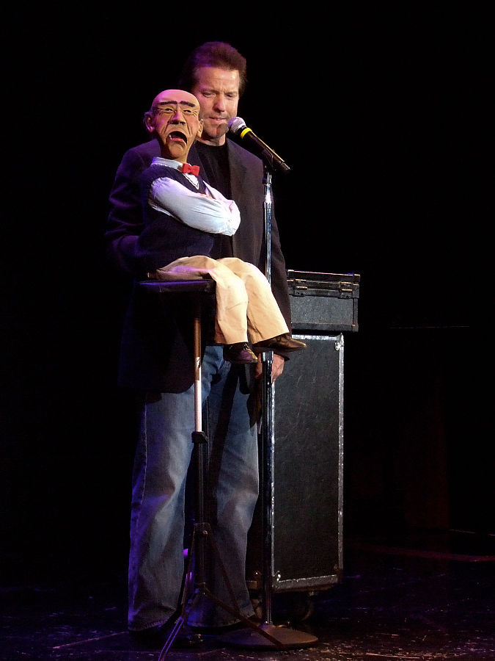
The Ventriloquist Illusion
Jeff Dunham YouTube
Why did you like this video?
Does the puppet have a personality?
  Why?
How did the auditory influence affect visual localization?
Notes:
Activity: The Ventriloquist Illusion
Overview:
Time: 5-6 minutes including discussion.
Materials: Play the YouTube video at https://www.youtube.com/watch?v=u7u1o1dTw_s
Directions: Tell students that you are about to show them a video clip of a famous ventriloquist. Then ask them the questions below:
(Click): Why did you like this video?
(Click): Does the puppet have a personality?
(Click): Why?
(Click): How did the auditory influence affect visual localization?
Debrief students by discussing the research on the “ventriloquist illusion” (Vroomen & De Gelder, 2004). As described in the module, “When a ventriloquist appears to make a puppet speak, she fools the listener into thinking that the location of the origin of the speech sounds is at the puppet’s mouth. In other words, instead of localizing the auditory signal (coming from the mouth of a ventriloquist) to the correct place, our perceptual system localizes it incorrectly (to the mouth of the puppet).”
Explain why this might happen:
From the Module:
“Why might this happen? Consider the information available to the observer about the location of the two components of the stimulus: the sounds from the ventriloquist’s mouth and the visual movement of the puppet’s mouth. Whereas it is very obvious where the visual stimulus is coming from (because you can see it), it is much more difficult to pinpoint the location of the sounds. In other words, the very precise visual location of mouth movement apparently overrides the less well-specified location of the auditory information”.

Slide 18
Visual Illusion
This is a class activity on visual perception.
I am going to show you a blank screen.
I want you to stare at the dot that will appear at the center of the screen.
Notes:
Activity: Visual Illusion
Overview: This activity is a replication of a classic experiment by Shams, Kamitani, and Shimojo, (2000) called the double-flash illusion. The purpose is to have students experience how auditory stimuli sometimes influence how we remember visual stimuli.
Time: 4 minutes
Materials: All materials are in the accompanying PowerPoint presentation.
Directions:
(Click): This is a class activity on visual perception
(Click): I am going to show you a blank screen
First, tell students that you want them to focus on the center point of the screen.
(Click): I want you to stare at the dot in that will appear at center of the screen
A blue dot will appear on (Click) in the middle of the screen
(Click): You don’t need to say anything to the students here, but click again and at the extreme edge of the screen, a white dot will appear along with an auditory event (beeping).
On slide 20 after they’ve seen the double-flash illusion, ask students how many white dots they saw? Have students write the number down and pass it to you.
Debrief students: Often, your students will report seeing two white dots when the flash is accompanied by two beeps. The number of heard beeps influences the number of seen flashes.

Slide 20
Visual Illusion
Please write down on a piece of paper, how many white dots you saw appear on the screen.
Notes:
Activity: Visual Illusion Continued
Now, ask students how many white dots they saw? Have students write the number down and pass it to you.
Debrief students: Often, your students will report seeing two white dots when the flash is accompanied by two beeps. The number of heard beeps influences the number of seen flashes.

Slide 21

What do these people sound like?
What do you think the woman in the video sounds like?
Notes:
Activity: What does this person sound like?
Overview: This activity is meant to demonstrate the crossmodal speech phenomenon
Directions: Before defining what crossmodal speech phenomenon is, show these two YouTube videos. When showing each video, make sure that the sound is off. After each video, have students explain what they thought the two people sounded like. Next, replay each video but with the sound turned on. After, you can discuss the crossmodal speech phenomenon: Often we have expectations of how people should sound based on how they talk and how they look. In this activity, students will be confronted with their stereotypes and perceptions. This slide contains the first video go to → Next Slide to play the second one.
Time: 3-5 minutes
Materials: The video is embedded into the slide, so all you do is click on it to play.
Here is a link to the video just in case: https://www.youtube.com/watch?v=vNa1PHCy8qg
Please be aware that the video online is titled: My Man Voice and will give away to point of this activity to students.

Slide 22
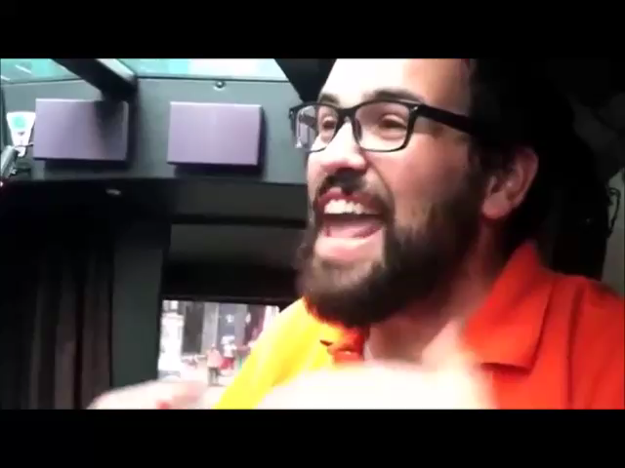
What do these people sound like?
What do you think the man in the video sounds like?
Notes:
Activity: What does this person sound like?
Overview: This activity is meant to demonstrate the crossmodal speech phenomenon
Directions: Before defining what crossmodal speech phenomenon is, show these two YouTube videos. When showing each video, make sure that the sound is off. After each video, have students explain what they thought the two people sounded like. Next, replay each video but with the sound turned on. After, you can discuss the crossmodal speech phenomenon: Often we have expectations of how people should sound based on how they talk and how they look. In this activity, students will be confronted with their stereotypes and perceptions. This slide contains the second video.
Time: 3-5 minutes
Materials: The video is embedded into the slide, so all you do is click on it to play
Here is a link to the male video just in case:
https://www.youtube.com/watch?v=8UoJ-34Ssa0
Please be aware that the video online is titled Girl Voice which will give away the point of the discussion to students.

Slide 23
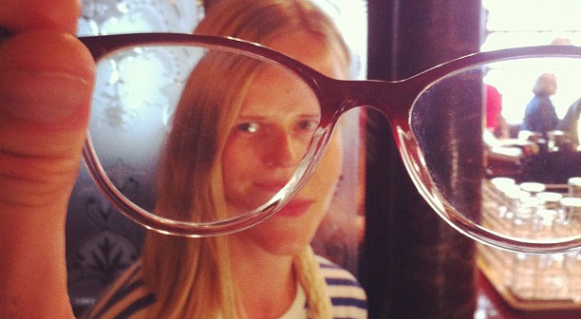
Conclusion
Notes:
In this module, we have reviewed some of the main evidence and findings concerning the role of multimodal perception in our experience of the world. It appears that our nervous system (and the cortex in particular) contains considerable architecture for the processing of information arriving from multiple senses. Given this neurobiological setup, and the diversity of behavioral phenomena associated with multimodal stimuli, it is likely that the investigation of multimodal perception will continue to be a topic of interest in the field of experimental perception for many years to come.

Slide 24

CAT: Direct Paraphrasing
  I want you to “translate” what we have talked about today.
  Pick one key concept (e.g., crossmodal speech, McGurk Effect, superior colliculus, etc. ) and write, in your own words, a one or two sentence definition.
Notes:
Classroom Assessment Activity (CAT): Direct Paraphrasing
In this CAT, have students reflect upon the lesson by the process of direct paraphrasing. Ask students to write a layman’s "translation" of something they have just learned -- geared to a specified individual or audience -- to assess their ability to comprehend and transfer concepts. Categorize student responses according to characteristics you feel are important. Analyze the responses both within and across categories, noting ways you could address student needs.
If you do not conclude with this Classroom Assessment Technique (CAT), it would helpful to use another CAT. It could be in the form of a:
Muddy point
One-minute paper
Background knowledge
What’s the Principle?
Defining features Matrix:
For more information on CATs click here: http://cft.vanderbilt.edu/guides-sub-pages/cats/

Slide 25
Photo Attribution
Slide 1 | Photo Credit: Perception process Laurens van Lieshout https://commons.wikimedia.org/wiki/File:Perception_process.png#/media/File:Perception_process.png Public Domain
Slides 2 & 5 | Photo Credit: Ongeval 06/06/2006 Beau Maes https://www.flickr.com/photos/94651813@N00/161822227/ https://creativecommons.org/licenses/by/2.0/
Slide 4 | Photo Credit: at the other side Jaume Escofet https://www.flickr.com/photos/28842017@N00/5759589756/ https://creativecommons.org/licenses/by/2.0/ Photo Credit: person woman park music Pexels https://www.pexels.com/photo/person-woman-park-music-3084/ https://creativecommons.org/publicdomain/zero/1.0/ Photo Credit: Birthday Girl! Sarah Skiold-Hanlin https://www.flickr.com/photos/131494485@N02/16928635107/ https://creativecommons.org/licenses/by/2.0/ Photo Credit: Love For Life Dr. Abdullah Naser https://www.flickr.com/photos/abraj/192077198/ https://creativecommons.org/licenses/by-nc/2.0/
Slide 7 | Photo Credit: Questions1 Grisel D´An https://www.flickr.com/photos/128454566@N06/15893429463 https://creativecommons.org/licenses/by-nc/2.0/
Slide 9 | Photo Credit: Superior colliculus Anatomist90 https://en.wikipedia.org/wiki/Superior_colliculus#/media/File:Slide5ff.JPG http://creativecommons.org/licenses/by-sa/3.0/
Slide 10 | Photo Credit: synapse Allan Ajifo https://www.flickr.com/photos/125992663@N02/14414381350 https://creativecommons.org/licenses/by/2.0/
Slide 11 | Photo Credit: Motor and Sensory Regions of the Cerebral Cortex Blausen.com staff https://en.wikipedia.org/wiki/Primary_motor_cortex#/media/File:Blausen_0103_Brain_Sensory%26Motor.png http://creativecommons.org/licenses/by/3.0/
Slide 13 | Photo Credit: Red wraps and martinis Magda Wojtyra https://www.flickr.com/photos/78208003@N00/279597835/ https://creativecommons.org/licenses/by-nc-sa/2.0/
Notes:
Photo Attribution Slide

Slide 26
Photo Attribution
Slide 14 | Photo Credit: 2013 09 27 COE orientation 1434 uoeducation https://www.flickr.com/photos/uoeducation/10745109524/ https://creativecommons.org/licenses/by-nc/2.0/
Slide 16 | Photo Credit: Singer alisaapps https://pixabay.com/en/singer-musician-woman-headphones-340212/ https://creativecommons.org/publicdomain/zero/1.0/deed.en
Slide 17 | Photo Credit: Jeff Dunham at the comedy night sponsored by Image Entertainment Cameron Yee https://commons.wikimedia.org/wiki/File:Jeff_Dunham_and_Walter_(2007).jpg#/media/File:Jeff_Dunham_and_Walter_(2007).jpg http://creativecommons.org/licenses/by/2.0/
Slide 21 | MY “MAN” VOICE [Video File]. Retrieved from: https://www.youtube.com/watch?v=vNa1PHCy8qg
Slide 22 | Girl Voice [Video File]. Retrieved from: https://www.youtube.com/watch?v=8UoJ-34Ssa0
Slide 23 | Photo Credit: Stine Olstad – perception hughesjoseph https://www.flickr.com/photos/joehug/9455785849 https://creativecommons.org/licenses/by-nc-sa/2.0/
Slide 24 | Photo Credit: Illustrated silhouette of a black cat nehtaeh79 http://www.freestockphotos.biz/stockphoto/16624 http://creativecommons.org/publicdomain/zero/1.0/
Notes:
Photo Attribution Slide

